Slide 1
Administering a Successful Club Meeting:
The Heart of Rotary

Slide 2
ROTARY CLUB MEETINGS
Types of meetings:
Weekly club meetings
Monthly board meetings
Club assemblies
Governor's official visit
Set these dates well ahead of time.
Communicate these dates with EVERYONE!
Notes:
Might want to mention that weekly club meeting requirement has been modified somewhat. Some clubs are changing models to incorporate service projects and socials. Could do a purely social meeting once per month.
In addition to governor’s official visit, mention that AGs are to be visiting quarterly – not an “official” visit with any formalities, but expect them and check in with them if they’re not showing.

Slide 3
ROTARY CLUB MEETINGS
District Governor's official visit protocol
Arrange for someone meet the DG at the door early and assist him with his materials.
Introduce the Assistant Governor with a personal touch.
The official introduction of the DG is done by your Assistant Governor.
When the DG is introduced and goes to podium, those in attendance stand and applaud out of respect for the office he holds in District 6460.
The DG is the only program that day.
When the DG has finished his presentation, stand and applaud again in respect and appreciation.
Determine ahead of time if the DG’s spouse is attending
and make the appropriate arrangements.
The DG may wish to meet with your club board or leadership before or after the meeting. Be sure to arrange for that if requested.

Slide 4
ROTARY CLUB MEETINGS
Club Programming – You want people to come, right?
Establish a committee to find speakers.
Invite local business people to share their stories – membership opportunities?
Folks like learning more about their fellow Rotarians.
District leadership is glad to present.
Include information from the 5 Avenues of Service and 6 Areas of Focus

Slide 5
ROTARY CLUB MEETINGS
Avenues of Service
Club service- focuses on strengthening fellowship and ensuring the effective function of the club.
Vocational service- encourages Rotarians to serve others through their vocation and to practice high ethical standards.
Community service- covers projects and activities the club undertakes to improve life in its community
International service- includes actions taken to expand humanitarian reach around the globe that promotes world understanding and peace.
Youth Service- recognizes the POSITIVE changes implemented by youth and young adults through leadership development within the following New Generations activities: RYLA, EARLYACT, INTERACT, ROTARACT, and Rotary Youth Exchange.

Slide 6
ROTARY CLUB MEETINGS
Areas of Focus
Peace and conflict prevention/resolution.
Disease prevention and treatment.
Water and sanitation.
Maternal and child health.
Basic education and literacy.
Economic and community development.

Slide 7
ROTARY CLUB MEETINGS
Speaking tips
Stand up straight.
Speak at a moderate pace.
Make eye contact.
Be yourself!

Slide 8
ROTARY CLUB MEETINGS
Sending an email a few days prior to your weekly meeting to all Rotarians assigned to perform a role at the meeting can be helpful.
If your Club utilizes a sound system, having it tested prior to the start of meetings is appreciated by all concerned.
Watch the content/timing of your meeting so you provide the guest speaker adequate time for his/her presentation.
Starting and ending on time is essential.

Slide 9
ROTARY CLUB MEETINGS
Final Thoughts…..
Know your own strengths and weaknesses.
Use the strengths of your club leaders and members.
Connect with the district through your AG and District Committee chairs.
Develop your Rotary story and share it often.
Remain flexible.
Have well defined goals for your club.

Slide 10
P.E.T.S. Orientation
ROTARY DISTRICT 6460
PLANNING A SUCCESSFUL
ROTARY YEAR

Slide 11
KEY DATES
Midwest P.E.T.S. March 3-5, 2017
District Assembly April 29, 2017
District Governor’s Installation Late June/Early July
Official Club Visit (list forthcoming)
District Conference/Zone Institute Sept. 7-10, 2017
Club Elections BEFORE December 1, 2017
Rotary International Convention June 10-14, 2017 in Atlanta, Georgia

Slide 12
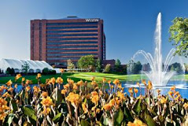
MIDWEST P.E.T.S.
MARCH 3-5, 2017
The Westin Chicago Northwest
400 Park Blvd, Itasca, IL 60143

Slide 13
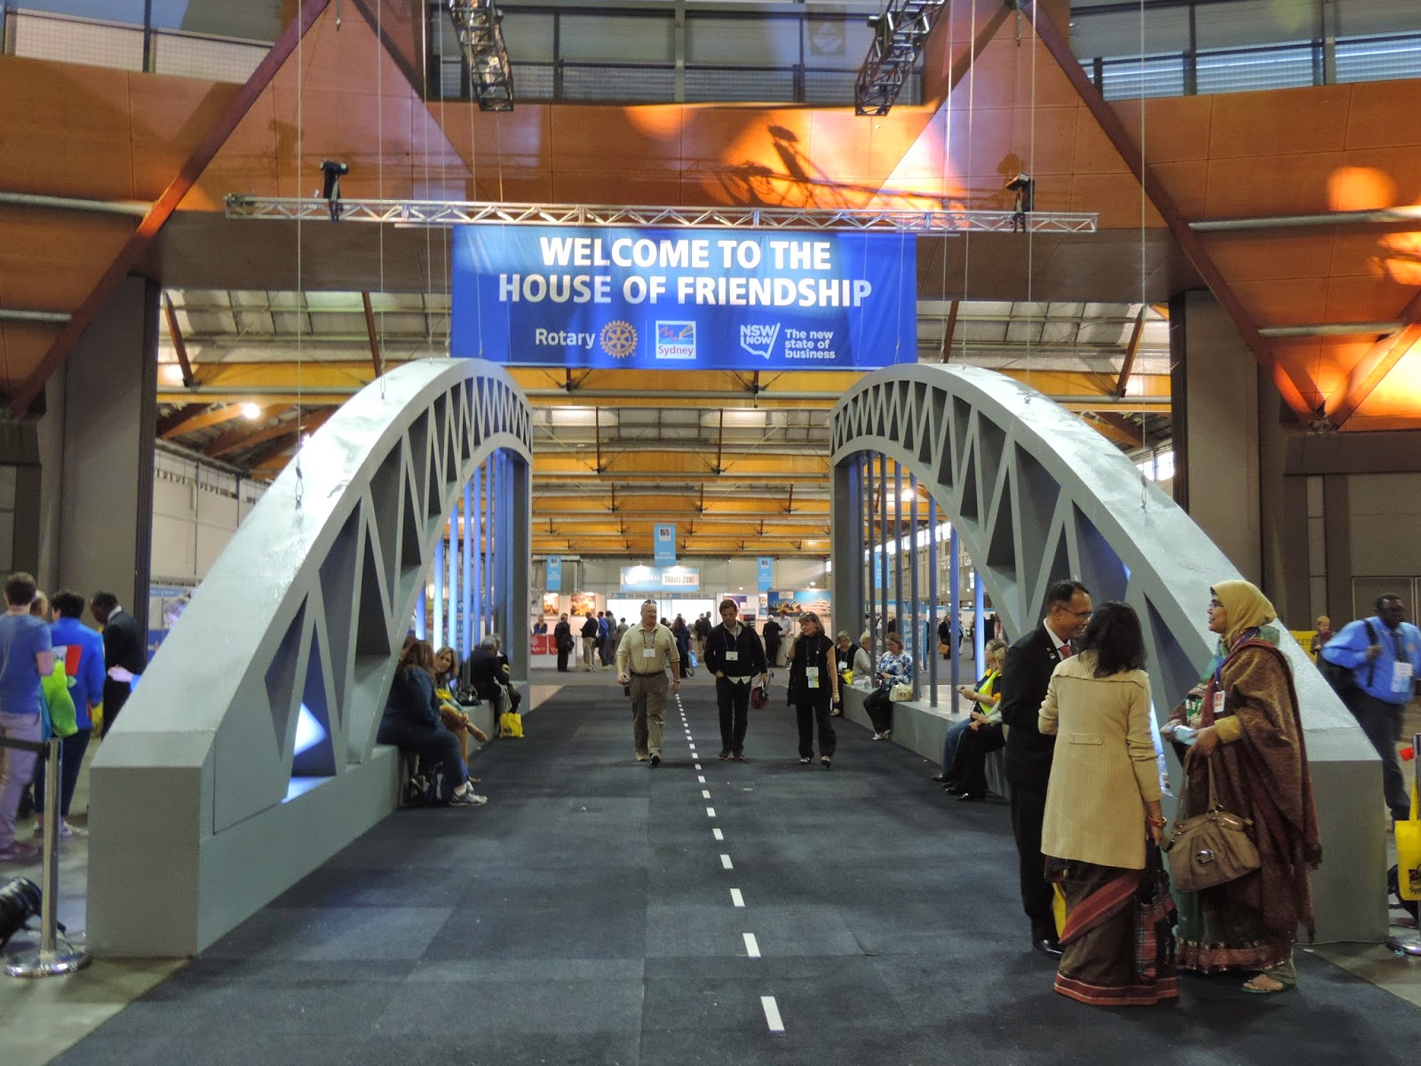
Register On-Line
www.midwestpets.org

Slide 14
DO I HAVE TO ATTEND MIDWEST P.E.T.S. AT THE WESTIN IN ITASCA?
YES!!!
And why wouldn’t you want to?!
You will meet PEs from 7 districts for an amazing time of networking.
You will fulfill the training requirement to serve as your club president.

Slide 15
District Assembly
WHO: Your club’s committee chairs, officers, and potential leaders
WHAT: A condensed training for officers/chairs that includes Rotary International updates and grant certification
WHEN: April 29, 2017
WHERE: Illinois Central College, East Peoria, Illinois

Slide 16
Meet Doug and Judy

Slide 17
ABCs OF THE DISTRICT GOVERNOR’S VISIT:
Assistant Governor makes the introduction
Board should be available to meet DG Doug
Confirm DG Doug is THE program

Slide 18
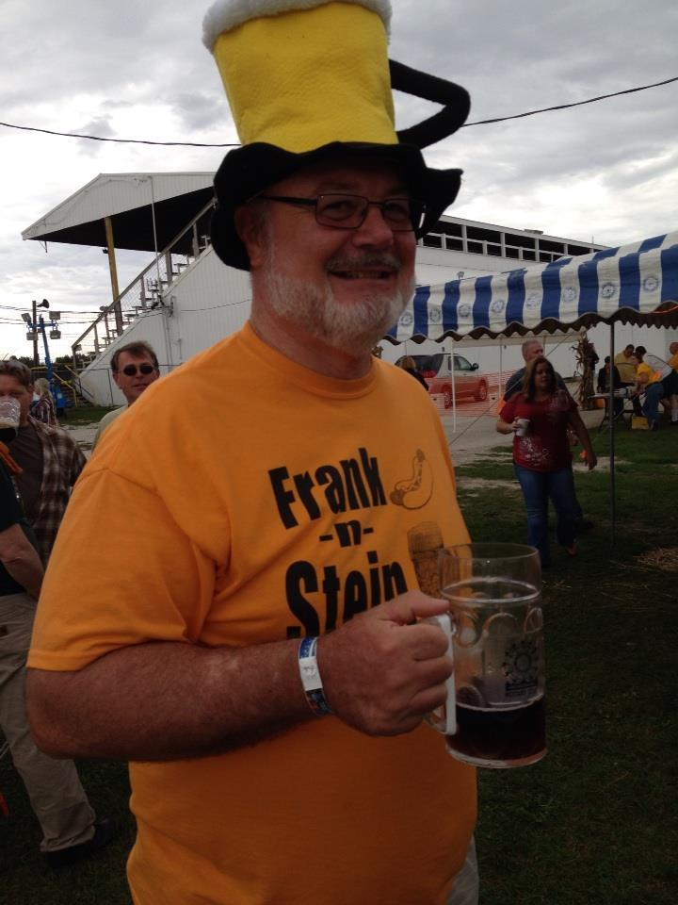
ASSISTANT GOVERNORS 10 available experts
They are your best resource for programs and projects.
They are the best way to communicate with the District Governor and District Chairs.
They have been successful club Presidents.
They visit your club a minimum of 4 times during the year.

Slide 19
DISTRICT CONFERENCE ZONE INSTITUTE September 7-10, 2017 Prairie Capital Convention Center Springfield, IL

Slide 20
CLUB ELECTION
ELECTION should be completed prior to December 1. Then electronically post names to Rotary.org by December 1st for the next year’s Club President , Club Secretary and Club Treasurer.

Slide 21
ROTARY INTERNATIONAL CONFERENCE
June 10-14, 2017

Slide 22
District 6460 Club Grants 2017-2018
Receive up to $2,000.00 for a new, one-time only local service project
* Applications will be due in August 2016 (the month after your presidency begins) so begin identifying projects NOW
* Contact (outgoing) Club Grants Chair Ryan Byers – byersrd@gmail.com – for more information

Slide 23
NEXT STEPS
Register for Midwest P.E.T.S. March 3 - 5 , 2017 in Itasca.
Communicate with your club leaders regarding their participation at District Assembly April 29, 2017 at Illinois Central College in East Peoria
Watch for details on the District Governor’s Installation
Collaborate with your AG for the Governor's official club visit.
Begin to promote District Conference September 7-10 at the Prairie Capitol Convention Center in Springfield.
Conduct club elections before December 1, 2017
Save the Date Rotary International Conference June 10-14 in Atlanta

Slide 24
QUESTIONS ?

